Slide 1


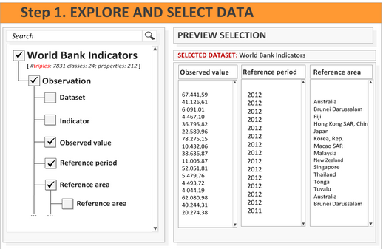
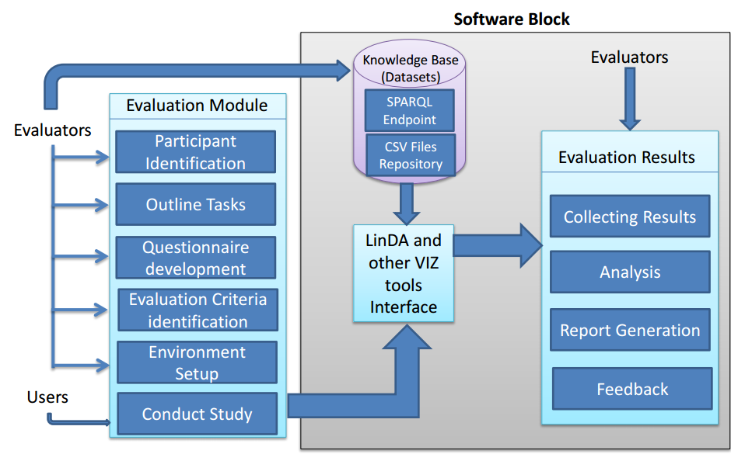
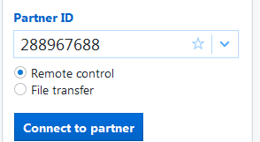
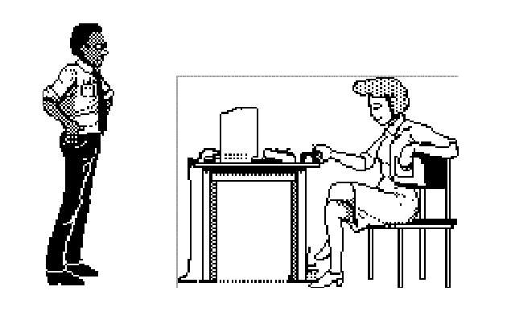

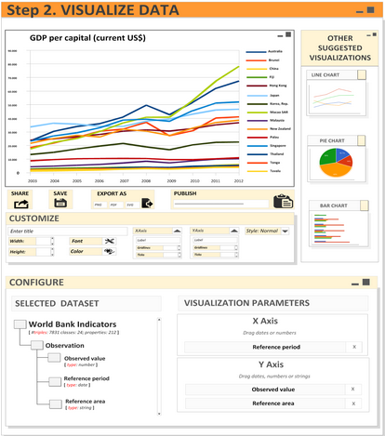




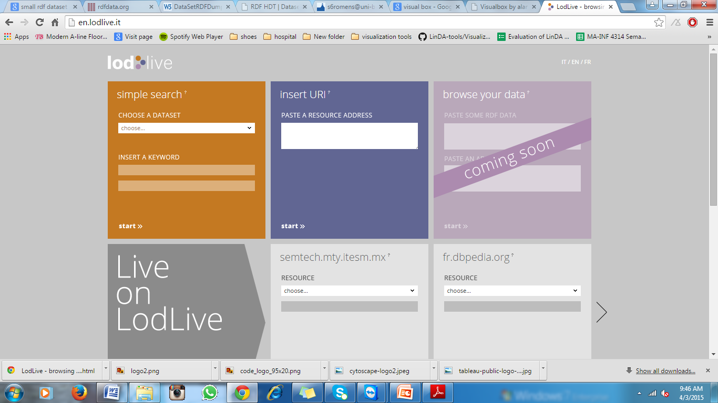


Evaluation of LinDA and comparison with other tools for visualization of Linked datasets
About & How-To Access Guide
Evaluation process - https://github.com/EIS-Bonn/MA-INF4314-Lab/tree/master/A-EvaluationLinDA-Fabrizio
LinDA project - https://github.com/LinDA-tools/Visualization
Conducted by
Rose-Mary Owusuaa Mensah
Nishananth Baskaran
Ugochukwu Chimbo Ejikeme
Nikhil Patra
Quick links:
Summary of the Evaluation process
The aim of the LinDA project is to make the benefits of Linked Open Data accessible to SMEs and data providers. This involves building a system of tools for visualizing Linked Data to assist SMEs in their daily tasks by hiding complexity through automation and an intuitive user interface. This evaluation process was conducted to assess the software and provide feedback to the developers
Usability test on LinDA software was conducted with twenty(20) people ranging from novices to experts. Methods adopted in the evaluation process included questionnaires, cognitive walkthrough and interviews. Each user was given a maximum of seven (7) tasks to perform on the system. See bottom of poster for details on the tasks.
Comparison of LinDA was carried out against other visualization tools such as Tableau public, CODE project and RDF:Synopsviz, Lumira and a few others. Emphasis was placed on analyzing properties concerning product quality which are usability, efficiency, scalability, visual representation, format of datasets and customization.
Virtual Machine
Sample LinDA interface
LinDA evaluation process: Architecture Diagram
Ubuntu login: comp
Name: LinDA Visualization Production
OS: Ubuntu (64 bit)
Base memory : 4096MB
Team viewer access
Usability Task | Description
Task 1 | Dataset selection
Task 2 | Choosing parameters
Task 3 | Visualize data/ navigate chart
Task 4 | Modify parameters
Task 5 | Change data labels
Task 6 | Save visualization
Task 7 | Visualizing another dataset
EIS Lab WinSem 2015 Group A
https://github.com/EIS-Bonn/MA-INF4314-Lab/tree/master/A-EvaluationLinDA-Fabrizio
Other Visualization tools
LinDA Evaluation Results
Detailed information on evaluation reports can be found on Github link : https://github.com/EIS-Bonn/MA-INF4314-Lab/blob/master/A-EvaluationLinDA-Fabrizio/dev/Evaluation%20reports/Group-A-Technical-System-Documentation.pdf
EIS
Enterprise
Information Systems
Enterprise
Information Systems
29th March, 2015

